Slide 1

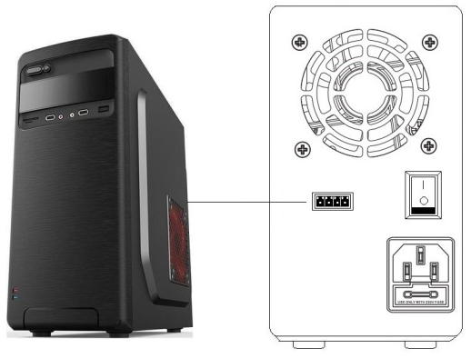
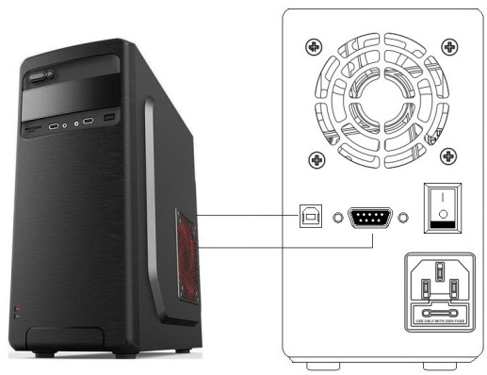
Online control instructions for DC power supply
This machine can be equipped with RS-232, RS-485, or USB transmission standards to communicate with the computer. The installation steps are as follows:
Connect the DC power supply to the PC using a communication cable.
Note: Factory machines are only shipped with USB communication cables, and RS-232 and RS-485 communication cables need to be purchased by customers themselves.
2. Place the PC and DC power supply in the startup state, and install the driver program and upper computer software of the DC power supply on the computer end.
3. Open the installed upper computer software to use it.
(RS-485 interface )
(RS-232/USB interface )
Download address of upper computer software and related materials ：
https://nice-power.com.cn/Download

Slide 2
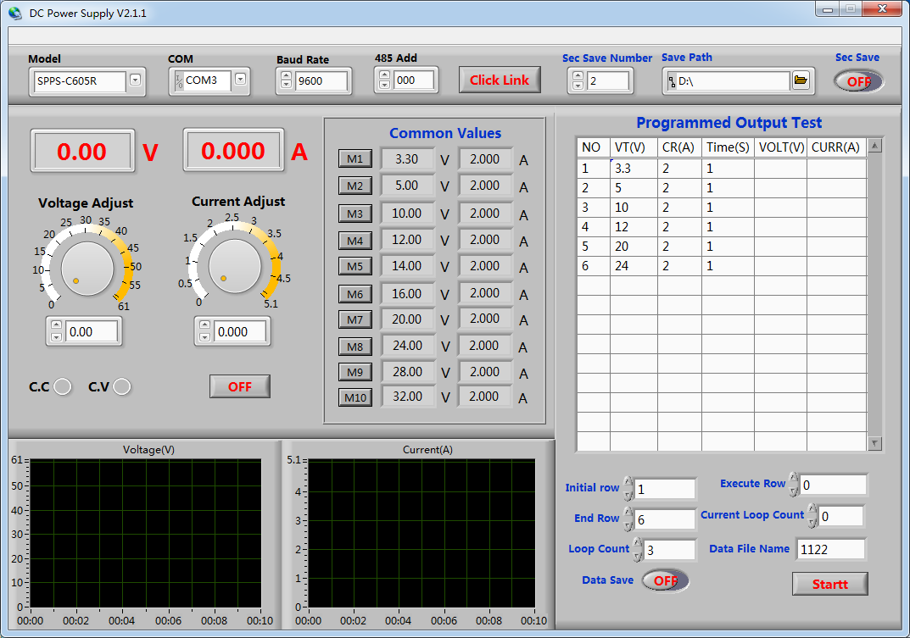
Commonly used values, click the corresponding button to directly output the corresponding value
Only models with RS-485 functionality require setting addresses
Communication connection or disconnection button between upper computer software and DC power supply
After installing the driver, refresh and select the corresponding COM port
Model Selection
Current adjustment knob
Edit the required voltage, current value, and output time by serial number here, and the power supply can achieve programming output
Voltage adjustment knob
Voltage value input
Current value input
Output control button
Programming control project
Voltage output curve
Current output curve
Programming output start button, click the start button, and the power supply will output according to the programming steps and numerical values

